Slide 1
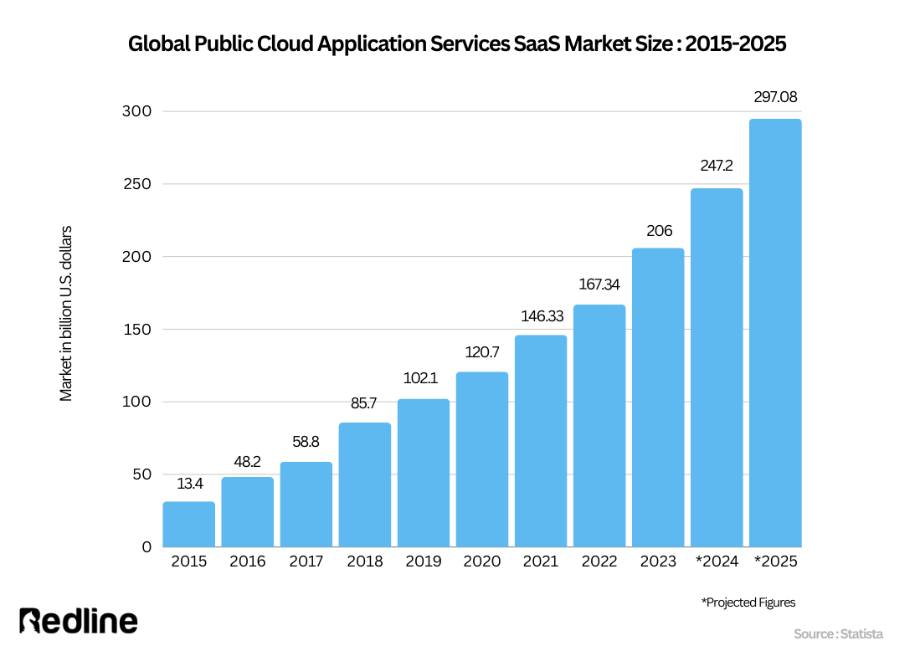
The distinction between Software products, Information systems and Services
Students: Muhammod Belal Uddin (23032697) Mohammud Jama (23026669) Sadique-Ur Rahman (23032308) Jobayer Rahman Chowdhury- 22036277
CS5002 Software Engineering
Abstract
Information systems serve as complete frameworks that combine software and procedures to manage organisational information, even if software products are standalone programs designed for specific reasons. Software services, often offered through subscription-based models, give users scalable and adaptable access to software capabilities. This study focusses on their contributions to organisational and technical innovation by analysing their definitions, characteristics, connections, and practical implementations.
References
https://www.pearson.com/nl/en_NL/higher-education/subject-catalogue/information-systems/Laudon-management-information-systems-digital-firm-16e.html
https://www.researchgate.net/publication/336251012_Software_Engineering_A_Practitioner's_Approach_9th_Edition
https://redline.digital/saas-industry-statistics/
Literature review
Information Systems
Information systems are defined as "a set of interrelated components working together to collect, process, and disseminate information for organizational decision-making" (Laudon & Laudon, 2020). They are comprehensive frameworks that include hardware, software, data, people, and processes to support business operations and strategic goals. Examples include Enterprise Resource Planning (ERP) systems and Customer Relationship Management (CRM) systems, which integrate multiple components to streamline workflows and enhance decision-making.
Software Products
Software products are standalone applications developed to address specific needs or perform tasks. Pressman (2019) defines software products as "commercial off-the-shelf (COTS) solutions designed for widespread use with fixed functionality." They are tangible, user-focused, and often distributed as installable packages or downloadable programs. Examples include Microsoft Office applications like Word and Excel, which provide predefined tools for productivity.
Software Services
Software services refer to applications delivered over the internet, typically through a subscription-based model. Software services are "cloud-hosted solutions that allow users to access software capabilities without requiring installation or maintenance." Services like Google Workspace and Salesforce CRM exemplify this model, offering flexibility, scalability, and ease of access. This approach has gained traction due to its cost-effectiveness and ability to adapt to evolving business needs.
Conclusion/Further Scope
Key Insights:
Information systems are holistic and serve as the backbone of organizational technology. Software products are focused, standalone tools with predefined functionality .Software services offer scalability, flexibility, and convenience. Final Thought: Together, these concepts create a robust ecosystem, empowering organizations to achieve operational and strategic goals effectively.
Emerging Trends: Integration of AI and machine learning into information systems for predictive analytics. The rise of hybrid models combining software products and services.
Challenges: Data security and compliance in cloud-hosted services. Managing costs and maintaining flexibility in a rapidly evolving market.

